Slide 1
XML Grid in a Nutshell Training Session
Eyal Maaravi

Slide 2
Agenda
Introduction
XML Grid Design
Usage in Service Test
Current Limitations

Slide 3
Introduction
A WinForms Control for graphically & textually viewing and manipulating XMLs.
Must be backed by an XML Schema (XSD).
Resides in the UTT Infra repository.

Slide 4
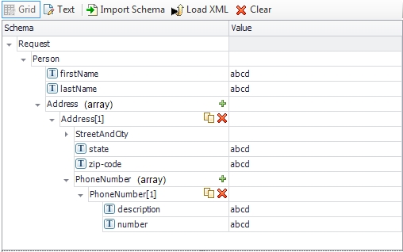
Grid View
GridView is based on DevExpress TreeList control.
Schema
Column
Value
Column

Slide 5
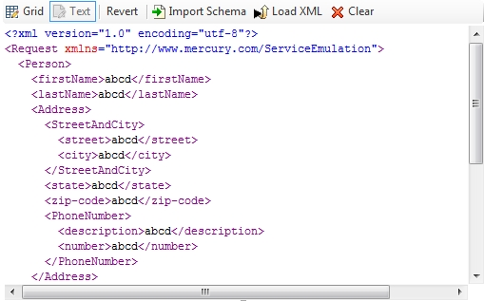
Text View
Enables textually viewing and manipulating the XML.
Grid -> Text: gets the XML from the XML column (GetXml) and shows it in the text view.
Text -> Grid: loads the xml from the text view to the grid (LoadXml).

Slide 6
JSON View
The XML Grid supports loading JSON format and displaying them on the grid.
Uses Newton.net to create a json model in memory
Serializes the model to xml
Infers the schema from xml
(alex)

Slide 7
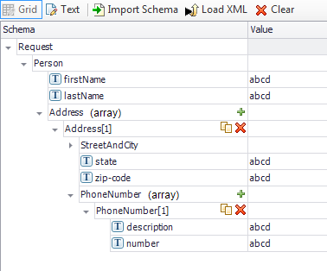
Schema Column
Shows the schema nodes of the loaded XSD.
Not pure schema – current XML instance may affect schema nodes (e.g. arrays).
Not part of the model’s column collection.

Slide 8
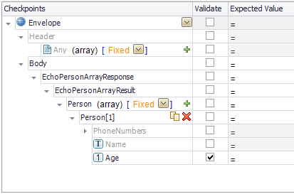
Checkbox Column
Allows selectively checking a subset of the schema nodes.
A key part of the XmlCheckpointsGrid.

Slide 9
Xml Column
Shows the content of XML instance.
Saves and maintains an XML document in the background.

Slide 10
Design Pattern
XML Grid follows the MVC pattern.
Presenter listens to events in the model, and updates the UI accordingly.
XmlGrid : UserControl
XmlGridView : TreeList
XmlTextView : UserControl
XmlGridModel
XmlGridPresenter
JsonTextView : UserControl

Slide 11
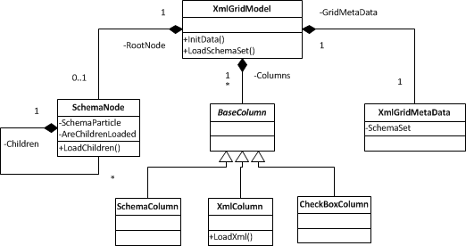
Grid Model Basic Class Diagram

Slide 12
Grid’s Main Operations
XmlGridModel.InitData(…) – loads the schema from the GridMetaData into the grid model.
XmlGridModel.LoadSchemaSet(…) – loads a schema set into the grid model.
XmlColumn.LoadXml(…) – loads an XML into the XmlColumn, given that it abides by the grid’s schema set.
SchemaNode.LoadChildren() – loads the children of the node.

Slide 13
Grid Commands
Common way to manipulate the grid model.
Extends the base Command class
Can be activated by both the UI and the model.
Example:
AutoValueCommand autoValueCommand =
new AutoValueCommand(this.ParentColumn.Owner.Model, this.ParentColumn.ModelColumn, this.ParentNode.ModelNode);
autoValueCommand.Do();

Slide 14

Decorators
A way to for a grid node to provide special capabilities and indications.
The model node provides the bitwise enum called DecorationFlags.
This enum is used by the UI to add decorators to the UI node.
Each decorator can contribute context menu items to the node – the context menu of a node is a union of all its decorators’ context menu items.

Slide 15
Lazy Loading
Both the grid model and UI utilize lazy loading.
Meaning: when calling InitData or LoadSchemaSet a shallow loading is done.
Further loading is done as needed (e.g. the user expands the node).
Use SchemaNode.AreChildrenLoaded to find out if the node has loaded its children.

Slide 16
Usage in Service Test
ST uses the Xml Grid extensively!
Used in several places:
Main property sheet
Linking dialog
XML Data Provider
Add REST Service dialog
Update WSDL dialog

Slide 17
Usage in Service Test – Cont’d
All major classes are subclassed in ST.
XmlGrid
XmlGridPresenter
SchemaNode
XsdPropertiesGrid
XsdPropertiesPresenter
XsdPropertyNode
XsdCheckpointsPropertiesPresenter
XmlCheckpointsGrid
XsdCheckpointsPropertiesGrid

Slide 18
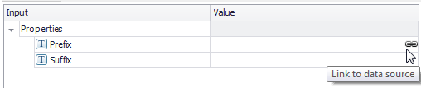
Usage in Service Test – Cont’d
Some of the grid’s features are pure grid.
Some are added at ST level.
For example, the link decorator

Slide 19

Usage in Service Test – Cont’d
Each activity declares its sections in its signature file:
The schema declared in the section is loaded to the respective XsdPropertiesModel property (subclass of XmlGridModel).
When added to the canvas, the section models are loaded to XML grid controls in the property tab controls.

Slide 20
Current Limitations
Only one XML column supported.
CDATA not supported.
Mixed content not supported.
Command undo not supported.

Slide 21
Notes
No WPF version.
Due to external usages, still uses .NET 3.5.
Doesn’t comply to HP’s ESB style.

